Slide 1

#LifeKoKaroLift
PG Diploma in ML/AI

Slide 2



Course : Machine Learning
Lecture On : NLP
Instructor : Manish Kumar

Slide 3
Natural Language Processing

Slide 4

LEXICAL PROCESSING

Slide 5
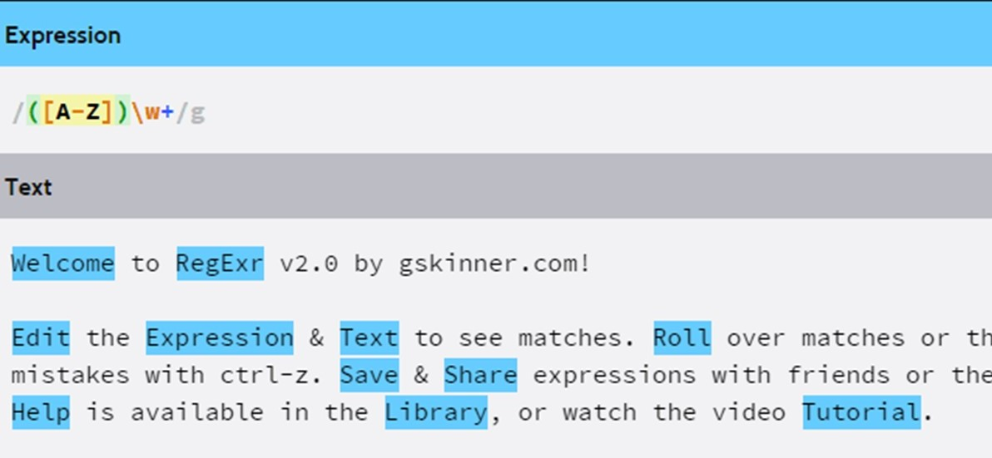

REGEX
Regular expressions (regex or regexp) are extremely useful in extracting information from any text by searching for one or more matches of a specific search pattern
Fields of application range from validation to parsing/replacing strings, passing through translating data to other formats and web scraping
The power of regular expressions is that they can specify patterns, not just fixed characters.

Slide 6

REGEX
Common Regex Patterns
^ Matches the beginning of a line
$ Matches the end of the line
. Matches any character
\s Matches whitespace
\S Matches any non-whitespace character
* Repeats a character zero or more times
*? Repeats a character zero or more times (non-greedy)
+ Repeats a character one or more times
+? Repeats a character one or more times (non-greedy)
[aeiou] Matches a single character in the listed set
[^XYZ] Matches a single character not in the listed set
[a-z0-9] The set of characters can include a range
( Indicates where string extraction is to start
) Indicates where string extraction is to end

Slide 7
BAG OF WORDS
A bag-of-words model, or BOW for short, is a way of extracting features from text for use in modeling, such as with machine learning algorithms.
The approach is very simple and flexible, and can be used in a myriad of ways for extracting features from documents.
A bag-of-words is a representation of text that describes the occurrence of words within a document.
Sentence 1 : It was the best of times.
Sentence 2 : It was the worst of times.
Example
Unique Words (Bag of words) = [“it”, “was”, “the”, “best”, “of”, “times”, “worst”]
Representations:
"it was the best of times" = [1,1,1,1,1,1,0]
"it was the worst of times" =[1,1,1,0,1,1,1]

Slide 8
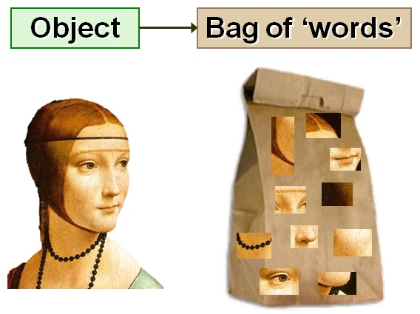

Drawbacks of BOW
In the above example, we can have vectors of length 11. However, we start facing issues when we come across new sentences:
If the new sentences contain new words, then our vocabulary size would increase and thereby, the length of the vectors would increase too.
Additionally, the vectors would also contain many 0s, thereby resulting in a sparse matrix (which is what we would like to avoid)
We are retaining no information on the grammar of the sentences nor on the ordering of the words in the text.

Slide 9
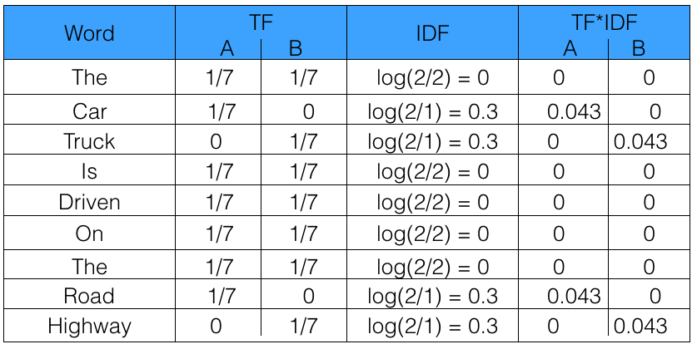
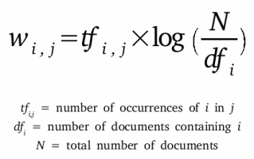
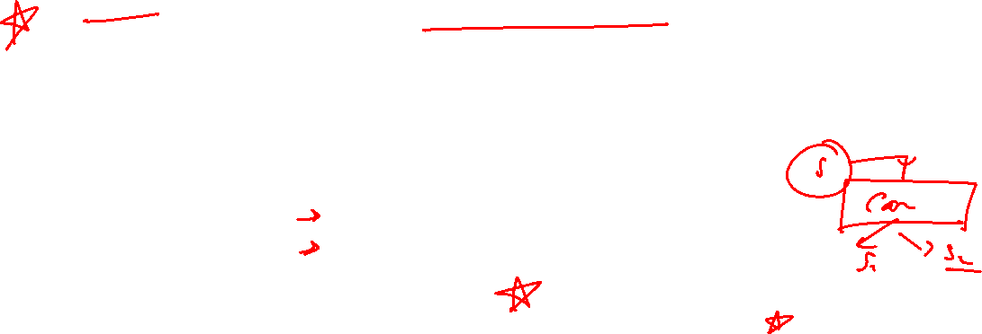
TFIDF
TF-IDF stands for “Term Frequency — Inverse Document Frequency”
It gives us the frequency of the word in each document in the corpus.
It is the ratio of number of times the word appears in a document compared to the total number of words in that document.
It increases as the number of occurrences of that word within the document increases.
Each document has its own term frequency.
Sentence 1 : The car is driven on the road.
Sentence 2 : The truck is driven on the highway.
Example

Slide 10

STEMMING
Stemming, in literal terms, is the process of cutting down the branches of a tree to its stem.
Language dependent
e.g., automate(s), automatic, automation all reduced to automat.
Stemmer operates on a single word without knowledge of the context, and therefore cannot discriminate between words which have different meanings depending on part of speech.
However, stemmers are typically easier to implement and run faster, and the reduced accuracy may not matter for some applications.
Porter’s Algorithm
rule based stemmer
produces stems, makes a number of mistakes
Krovetz Algorithm
algorithm + dictionary
if not found → strip suffix, lookup again
produces “words” not stems

Slide 11
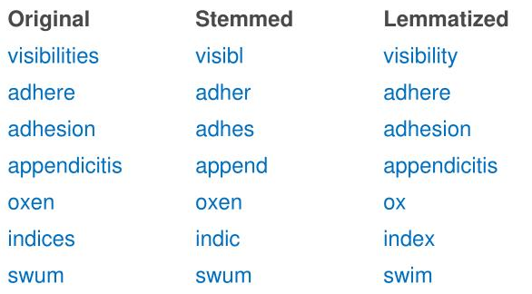

LEMMATIZATION
Lemmatization is closely related to stemming.
In linguistics, it is the process of grouping together the different inflected forms of a word so they can be analyzed as a single item.
Lemmatization changes the verb form, while keeping the meaning of the word the same.
Stemming will reduce “Worker” and “Speaker” to “Work” and “Speak” respectively while lemmatization will reduce them to “Worker” and “Speaker” because “Worker” is not an inflected form of “Work“, neither is “Speaker” an inflected form of “Speak”.

Slide 12

Why Phonetic Hashing ?
There are some cases that can’t be handled either by stemming nor lemmatization. You need another preprocessing method in order to stem or lemmatize the words efficiently.
Example,
‘disappearing’ : ‘dissappearng’ & ’dissapearing’.
After you stem these words, you’ll have two different stems
‘dissappear’ and ‘dissapear’.
You still have the problem of redundant tokens.
lemmatization won’t even work because it only works on correct dictionary spelling

Slide 13

Phonetic Hashing
Phonetic hashing buckets all the similar phonemes (words with similar sound or pronunciation) into a single bucket and gives all these variations a single hash code. Hence, the word ‘Dilli’ and ‘Delhi’ will have the same code.
A commonly used conversion results in a 4-character code, with the first character being a letter of the alphabet and the other three being digits between 0 and 9.
Retain the first letter of the term.
Change all occurrences of the following letters to '0' (zero): 'A', E', 'I', 'O', 'U', 'H', 'W', 'Y'.
Change letters to digits as follows:
B, F, P, V to 1.
C, G, J, K, Q, S, X, Z to 2.
D,T to 3.
L to 4.
M, N to 5.
R to 6.
H,W,Y to unencoded
Repeatedly remove one out of each pair of consecutive identical digits.
Remove all zeros from the resulting string. Pad the resulting string with trailing zeros and return the first four positions, which will consist of a letter followed by three digits.

Slide 14
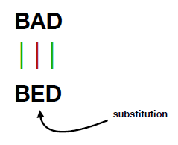
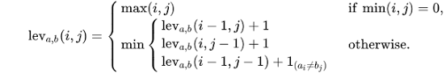

Edit Distance
This method was invented by Vladimir Levenshtein in 1965. The value refer to the minimum number of action (deletion, insertion and substitution) required to transform from one word to another word.
Simply put, edit distance is a measurement of how many changes we must do to one string to transform it into the string we are comparing it to.
As an illustration, the difference between “Frederic” and “Fred” is four, as we can change “Frederic” into “Fred” with the deletion of the letters “e” , “r”, “i” and ”c”.
To calculate the Levenshtein Distance, we have to go through every single word and using the minimum + 1 from
(i-1, j): It means left box (deletion)
(i, j-1): It means upper box (insertion)
(i-1, j-1): It means left upper box (substitution)
https://en.wikipedia.org/wiki/Levenshtein_distance

Slide 15
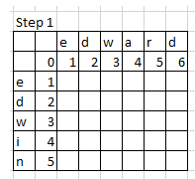
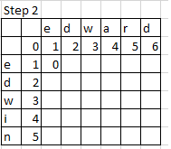
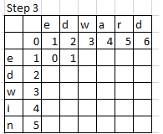
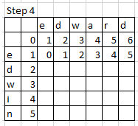
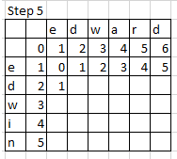
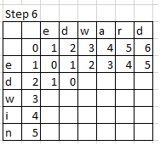
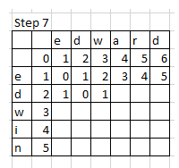
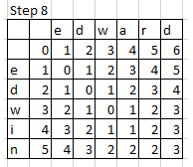
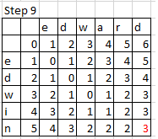
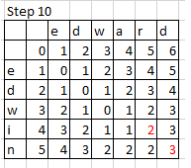
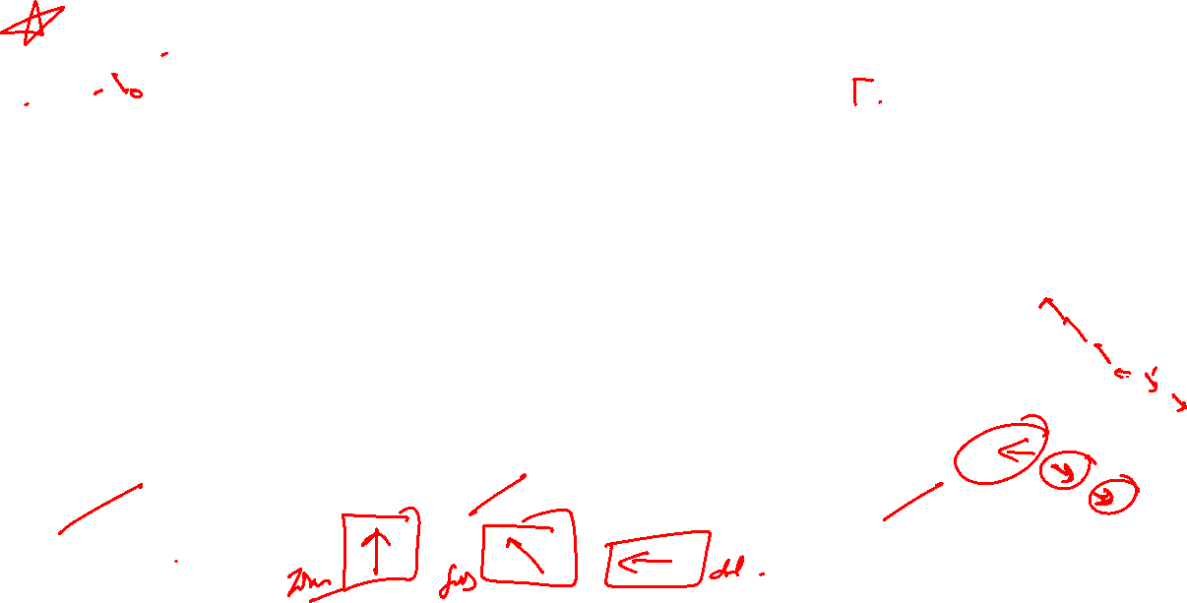
Example
Substitute “n” by “d”
2.Substitute “i” by “r”
3.Delete “a”

Slide 16

SYNTACTIC PROCESSING

Slide 17
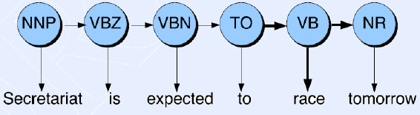

POS - TAGGING
Let’s say we ask Alexa a question - "Ok Alexa, where can I get the permit to work in Australia?". Now, the word 'permit' can potentially have two POS tags - noun and a verb. In the phrase 'I need a work permit', the correct tag of 'permit' is 'noun'. On the other hand, in the phrase "Please permit me to take the exam.", the word 'permit' is a 'verb'.
Assigning the correct POS tags helps us better understand the intended meaning of a phrase or a sentence and is thus a crucial part of syntactic processing
Some well known Use-cases:
text-to-speech (how do we pronounce “lead”?)
Helps in writing better regexps like (Det) Adj* N+ over the output etc.
Is generally included as a feature in Named Entity Recognition models

Slide 18
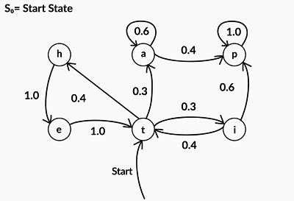
POS - TAGGING
Markov Chain
Markov models are probabilistic models that were developed to model sequential processes.
A Markov chain is used to represent a process which performs a transition from one state to other. This transition makes an assumption that the probability of transitioning to the next state is dependent solely on the current state.
Here, ‘a’, ‘p’, ‘i’, ‘t’, ‘e’, ‘h’ are the states and the numbers mentioned on the edges are transition probabilities.

Slide 19
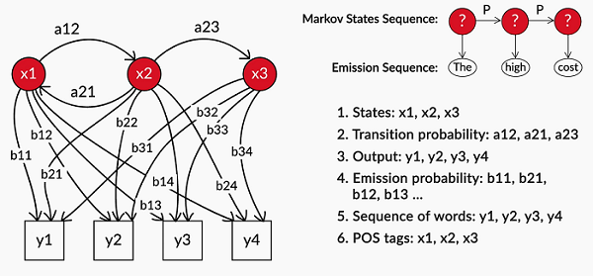
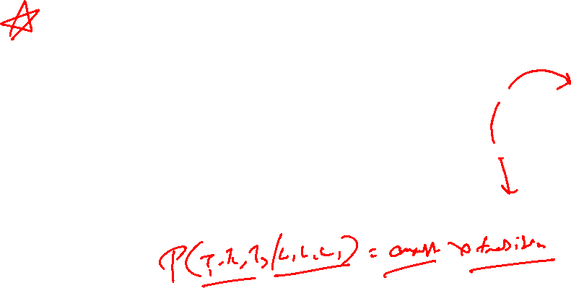
POS - TAGGING
Hidden Markov Model
The Hidden Markov Model (HMM) is an extension to the Markov process which is used to model phenomena where the states are hidden and they emit observations.
For Example, in POS tagging, what you observe are the words in a sentence, while the POS tags themselves are hidden. Thus, you can model the POS tagging task as an HMM with the hidden states representing POS tags which emit observations, i.e. words.
The hidden states emit observations with a certain probability. Therefore, along with the transition and initial state probabilities, Hidden Markov Models also have emission probabilities which represent the probability that an observation is emitted by a particular state.

Slide 20
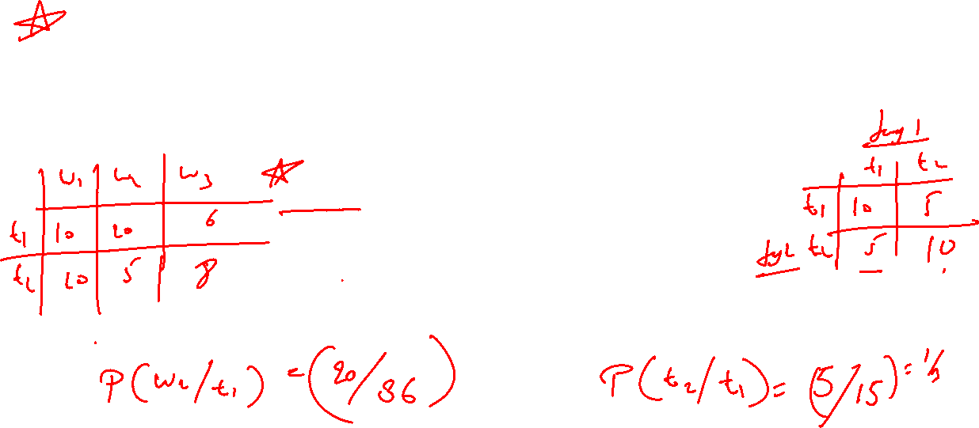
POS - TAGGING
Emission Probability of a word 'w' for tag 't':
P(w|t) = Number of times w has been tagged t/Number of times t appears
Transition Probability of tag t1 followed by tag t2:
P(t2|t1) = Number of times t1 is followed by tag t2/ Number of times t1 appears
In other words, we assign the tag t to the word w which has the max P(tag|word).
P(tag|word) = P(word|tag) * P(tag|previous tag)
= Emission probability * Transition probability

Slide 21
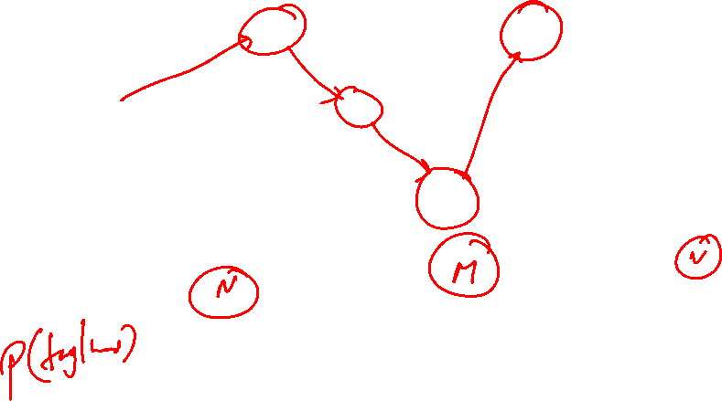
Viterbi
 | N | M | V
Mary | 4/9 | 0 | 0
Jane | 2/9 | 0 | 0
Will | 1/9 | 3/4 | 0
Spot | 2/9 | 0 | 1/4
Can | 0 | 1/4 | 0
see | 0 | 0 | 1/2
pat | 0 | 0 | 1/4
Jane
Will
Spot
Will
N
N
N
N
2/9
2/9
1/9
1/9
Emission Probability Matrix
<S>
M
M
M
M
<e>
0
3/4
0
3/4
 | N | M | V | <E>
<S> | 3/4 | 1/4 | 0 | 0
N | 1/9 | 1/3 | 1/9 | 4/9
M | ¼ | 0 | 3/4 | 0
V | 1 | 0 | 0 | 0
V
V
V
V
0
0
1/4
0
Transition Probability Matrix

Slide 22
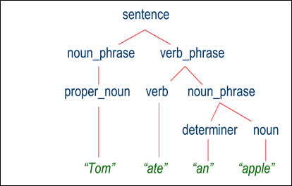
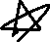
PARSING
https://www.nltk.org/book/ch08.html
Parsing means associating tree structure to a sentence, given a grammar (often a context-free grammar)
Algorithms:
Top-Down
LL – Parses input from Left-to-right, performing Leftmost derivation of the sentence
Recursive Descent – Tail Recursive or Pratt Parser
Bottom-Up
Precedence – Simple(recognizes the text's lowest-level small details first, then mid-level structures, and lastly highest-level overall structure), Shunting Yard
Bounded-Context – LR (Left-to-right, performing Rightmost derivation of the sentence)
A good parser shall have the ability to handle:
Prepositional Phrase attachment (e.g. – I saw a man with a telescope)
Coordination Scope
Gerunds vs Adjectives
Question Answering
Machine Translation (subject-verb-object or subject-object-verb)
Information Extraction
Speech understanding and Interpretation

Slide 23
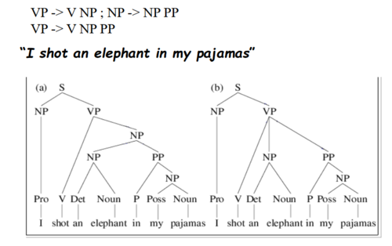


Probabilistic CFGs
The rules of a CFG can lead us to multiple parses of the same sentence, leading to ambiguity over which parse is the correct one for the sentence. Consider the sentence:
“I shot an elephant in my pajamas.”
(a) “I shot an elephant while I was wearing my pajamas.”
(b) “I shot an elephant that was wearing my pajamas.”
Obviously the second parse is nonsensical and we would like to pick the first parse as the proper one for the sentence PCFGs allow us to disambiguate by calculating which parse tree is the most probable.
Probabilistic Context-Free Grammars (PCFGs) are used when we want to find the most probable parsed structure of the sentence. PCFGs are grammar rules, similar to what you have seen, along with probabilities associated with each production rule.

Slide 24
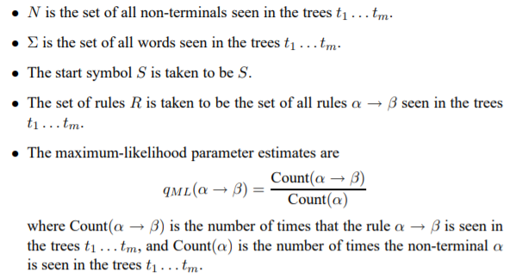

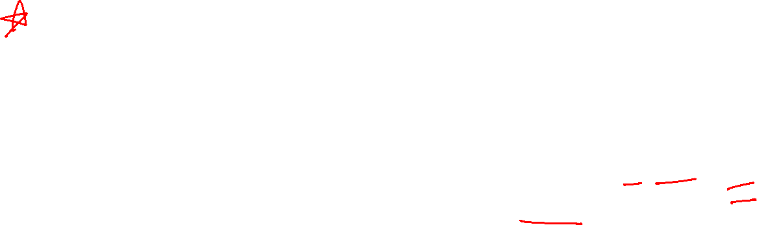
Deriving a PCFG from a Corpus
Having defined PCFGs, the next question is the following: how do we derive a PCFG from a corpus? We will assume a set of training data, which is simply a set 9 of parse trees t1, t2, . . . , tm
Each parse tree ti is a sequence of context-free rules: we assume that every parse tree in our corpus has the same symbol, S, at its root. We can then define a PCFG (N, Σ, S, R, q) as follows:
For example, if the rule VP → Vt NP is seen 105 times in our corpus, and the non-terminal VP is seen 1000 times, then
$$q\left(VP→VP NP\right)=\frac{105}{1000}$$

Slide 25



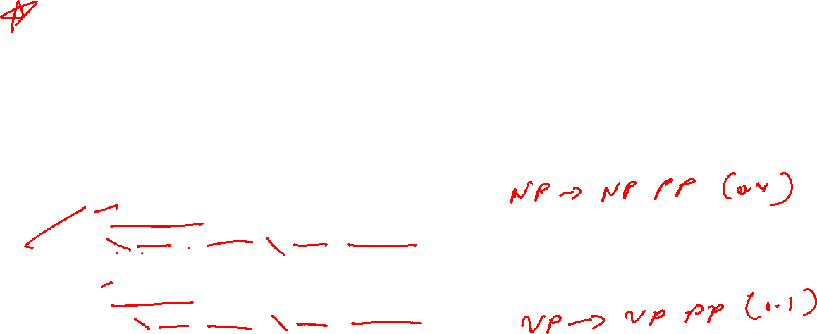
Poll
Given the Grammar which tree seems more probable ?
S -> NP VP [1.0]
PP -> P NP [1.0]
VP -> V NP [0.9] | VP PP [0.1]
NP -> NP PP [0.4]
P -> 'with' [1.0]
V -> 'saw' [1.0]
NP -> 'astronomer' [0.1] | 'ears' [0.18] | 'saw' [0.04] | 'stars' [0.18] | 'telescope' [0.1]
(S
(NP astronomer)
(VP (V saw) (NP (NP stars) (PP (P with) (NP telescope)))))
A
Practice in teams of 4 students
Industry expert mentoring to learn better
Get personalised feedback for improvements
(S
(NP astronomer)
(VP (VP (V saw) (NP stars)) (PP (P with) (NP telescope))))
B
23/05/19
11
Notes:
for any non-terminal X, the parameter values for all rules with that non-terminal on the left-hand-side of the rule must sum to one. We can verify that this property holds for the PCFG

Slide 26

Poll (Answer)
Given the Grammar which tree seems more probable ?
S -> NP VP [1.0]
PP -> P NP [1.0]
VP -> V NP [0.9] | VP PP [0.1]
NP -> NP PP [0.4]
P -> 'with' [1.0]
V -> 'saw' [1.0]
NP -> 'astronomer' [0.1] | 'ears' [0.18] | 'saw' [0.04] | 'stars' [0.18] | 'telescope' [0.1]
(S
(NP astronomer)
(VP (V saw) (NP (NP stars) (PP (P with) (NP telescope)))))
A
( P = 0.000648 )
Practice in teams of 4 students
Industry expert mentoring to learn better
Get personalised feedback for improvements
(S
(NP astronomer)
(VP (VP (V saw) (NP stars)) (PP (P with) (NP telescope))))
B
( P = 0.000162 )
23/05/19
11

Slide 27
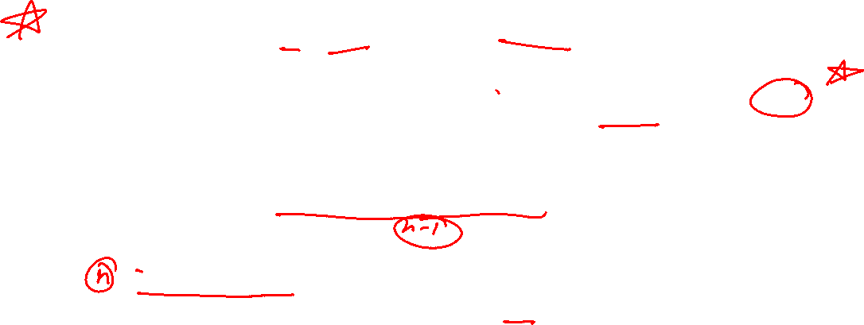
Chomsky Normal Form
Chomsky Normal Form. A grammar where every production is either of the form
A → BC (can’t be S) or A → c
(where A, B, C are arbitrary variables and c an arbitrary symbol).
The key advantage is that in Chomsky Normal Form, every derivation of a string of n letters has exactly 2n − 1 steps
Let n be the length of a string. We start with the (non-terminal) symbol S which has length n=1.
Using n−1 rules of form (non−terminal)→(non−terminal)(non−terminal) we can construct a string containing n non-terminal symbols.
Then on each non-terminal symbol of said string of length n we apply a rule of form (non−terminal)→(terminal). i.e. we apply n rules.
In total we will have applied n−1+n=2n−1 rules.
Practice :
https://www.cs.bgu.ac.il/~auto202/wiki.files/9a.pdf
https://www.youtube.com/watch?v=IiCbNhHwsws

Slide 28
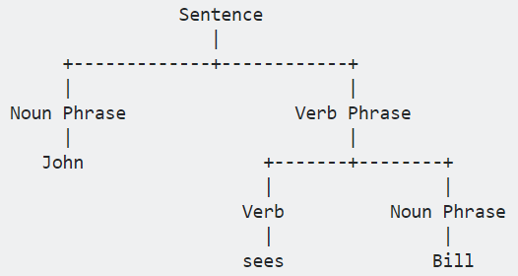
CONSTITUENCY PARSING
A constituency parse tree breaks a text into sub-phrases. Non-terminals in the tree are types of phrases, the terminals are the words in the sentence, and the edges are unlabelled.
For a simple sentence "John sees Bill", a constituency parse would be:
In fact, one of the good ways is to always parse the sentence with the constituency parser, and then, if needed, it performs a deterministic (rule-based) transformation on the constituency parse tree to convert it into a dependency tree.

Slide 29
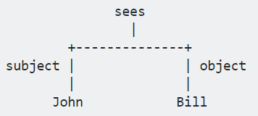
DEPENDENCY PARSING
A dependency parse connects words according to their relationships. Each vertex in the tree represents a word, child nodes are words that are dependent on the parent, and the edges are labelled by the relationship.
A dependency parse of the same sentence, "John sees Bill", would be:
If you are interested in sub-phrases within the sentence, you probably want the constituency parse. If you are interested in the dependency relationships between words, then you probably want the dependency parse.

Slide 30
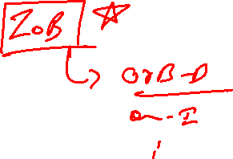
INFORMATION EXTRACTION
Information Extraction (IE) system that can extract structured data from unstructured textual data. A key component in information extraction systems is Named-Entity-Recognition (NER).
Assuming we are trying to make a conversational flight-booking system, which can show relevant flights when given a natural-language query such as “Please show me all morning flights from Bangalore to Mumbai on next Monday.” For the system to be able to process this query, it has to extract useful named entities from the unstructured text query and convert them to a structured format, such as the following dictionary/JSON object:
{
source: 'Bangalore',
destination: 'Mumbai‘, day: 'Monday',
time-of-day: 'morning‘
}
Using these entities, we could query a database and get all relevant flight results. In general, named entities refer to names of people, organizations (Google), places (India, Mumbai), specific dates and time (Monday, 8 pm) etc.

Slide 31
INFORMATION EXTRACTION
CRFs are used in a wide variety of sequence labelling tasks across various domains - POS tagging, speech recognition, NER etc
It is an discriminative probabilistic classifiers thus given a good data volume it out performs generative classifiers like HMMs.
Word and POS tag based features:
word_is_city, word_is_digit, is_numeric,is_title etc.
Label-based features: previous_label
CRFs use ‘feature functions’ rather than the input word sequence x itself. The idea is similar to how we add features for building a simple classification models like naive Bayes, decision tree classifiers etc.
CRFs can naturally consider state-to-state dependencies and feature-to-state dependencies. On the other hand, basic classification models do not consider such dependencies.

Slide 32
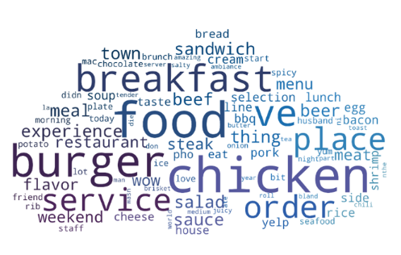
SEMANTIC PROCESSING

Slide 33

Semantic processing
Semantic processing is about understanding the meaning of a given piece of text.
But what do we mean by 'understanding the meaning' of text?
Example
“The bank will not be accepting cash on Saturdays. ”
“The river overflowed the bank.”
The word bank in the first sentence refers to the commercial (finance) banks, while in second sentence, it refers to the river bank.
Our brain can process sentences meaningfully because it can relate the text to other words and concepts it already knows.

Slide 34
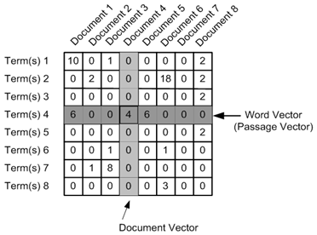
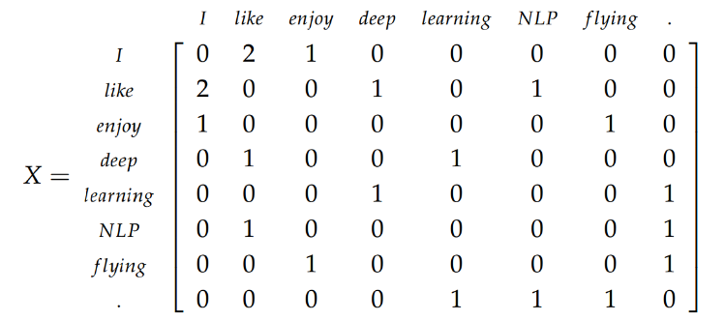
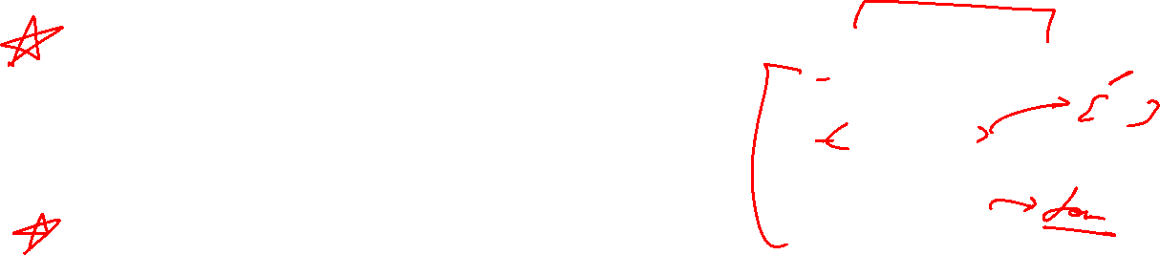
Semantic processing
“words which appear in the same contexts have similar meanings”
To exploit this property, we need to represent words in a format which encapsulates its similarity with other words.
The most commonly used representation of words is using 'word vectors‘.
The term-document occurrence matrix, where each row is a term in the vocabulary and each column is a document (such as a webpage, tweet, book etc.)
The term-term co-occurrence matrix, where the ith row and jth column represents the occurrence of the ith word in the context of the jth word.

Slide 35
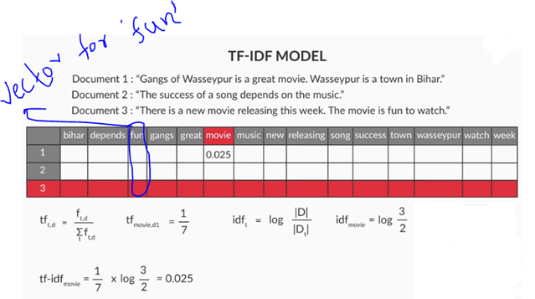
occurrence matrix
Tf-idf stands for term frequency-inverse document frequency, and the tf-idf weight is a weight often used in information retrieval and text mining. This weight is a statistical measure used to evaluate how important a word is to a document in a collection or corpus. The importance increases proportionally to the number of times a word appears in the document but is offset by the frequency of the word in the corpus.
TF(t) = (Number of times term t appears in a document) / (Total number of terms in the document).
IDF(t) = log (Total number of documents / Number of documents with term t in it).

Slide 36



Poll
Consider a document containing 100 words wherein the word cat appears 3 times and we have 10 million documents in which the word cat appears only in one thousand of these.
What will be the TF-idf weight of the word cat ?
A) 1.12
B) 0.11
C) 0.12
D) -1.12
Practice in teams of 4 students
Industry expert mentoring to learn better
Get personalised feedback for improvements
26-03-2022
11

Slide 37
Poll (Answer)
Consider a document containing 100 words wherein the word cat appears 3 times and we have 10 million documents in which the word cat appears only in one thousand of these.
What will be the TF-idf weight of the word cat ?
A) 1.12
B) 0.11
C) 0.12
D) -1.12
Practice in teams of 4 students
Industry expert mentoring to learn better
Get personalised feedback for improvements
26-03-2022
11

Slide 38
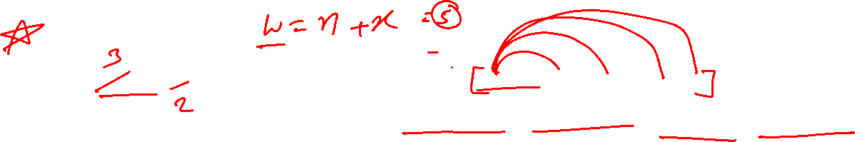
co-occurrence matrix
There are two ways of creating a co-occurrence matrix:
Using the occurrence context (e.g. a sentence):
Each sentence is represented as a context (there can be other definitions as well). If two terms occur in the same context, they are said to have occurred in the same occurrence context.
Skip-grams (x-skip-n-grams):
A sliding window will include the (x+n) words. This window will serve as the context now. Terms that co-occur within this context are said to have co-occurred.
“Man stumbled seconds Dursley man cloak upset knocked ground”
(Man, stumbled) (Man, seconds) (Man, Dursley) (Man, man)
(stumbled, seconds) (stumbled, Dursley) (stumbled, man) (stumbled, cloak)
(seconds, Dursley) (seconds, man) (seconds, cloak) (seconds, upset)
(Dursley, man) (Dursley, cloak) (Dursley, upset) (Dursley, knocked)
(man, cloak) (man, upset) (man, knocked) (man, ground)
(cloak, upset) (cloak, knocked) (cloak, ground)
(upset, knocked) (upset, ground)
(knocked, ground)

Slide 39
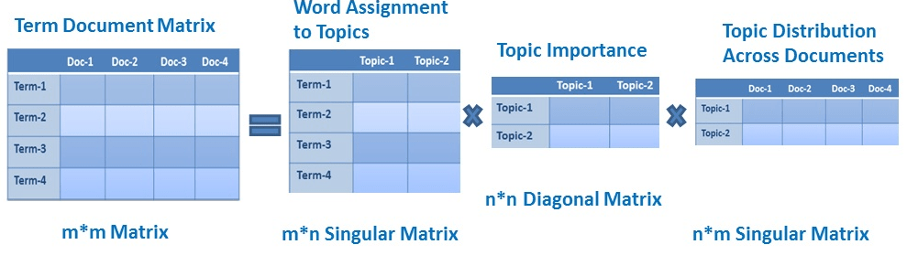
Latent Semantic Analysis
The occurrence and co-occurrence matrices have really large dimensions (equal to the size of the vocabulary V). This is a problem because working with such huge matrices make them almost impractical to use.
Word embedding's are a compressed, low dimensional version of these mammoth-sized matrices
Latent Semantic Analysis (LSA) uses Singular Value Decomposition (SVD) to reduce the dimensionality of the matrix.

Slide 40
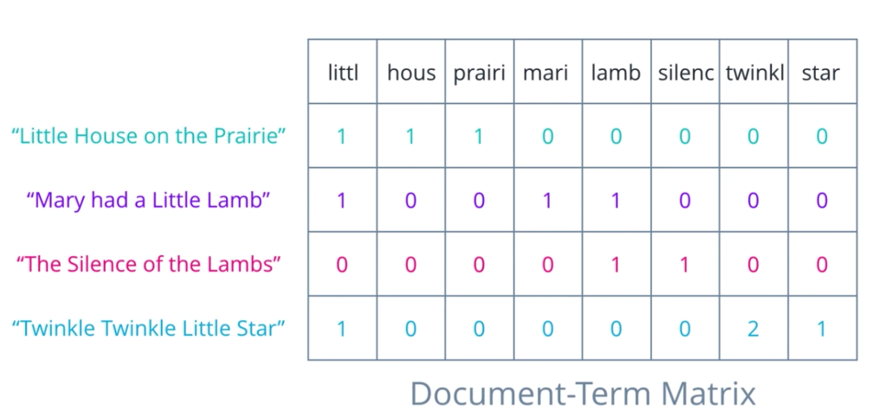
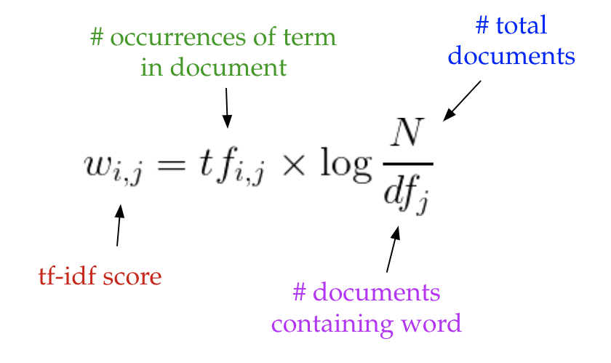
LSA
Latent Semantic Analysis, or LSA, is one of the foundational techniques in topic modeling. The core idea is to take a matrix of documents and terms — and decompose it into a separate document-topic matrix and a topic-term matrix.
Step 1 : Generate our document-term matrix A
Notes:
Intuitively, a term has a large weight when it occurs frequently across the document but infrequently across the corpus. The word “build” might appear often in a document, but because it’s likely fairly common in the rest of the corpus, it will not have a high tf-idf score. However, if the word “gentrification” appears often in a document, because it is rarer in the rest of the corpus, it will have a higher tf-idf score.

Slide 41
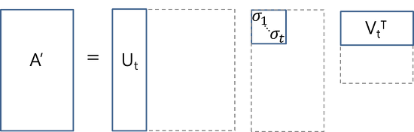
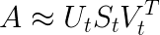
LSA
Step 2 : Perform Dimensionality reduction on the matrix A
This dimensionality reduction can be performed using truncated SVD. SVD, or singular value decomposition
U ∈ ℝ^(m ⨉ t) emerges as our document-topic matrix, and V ∈ ℝ^(n ⨉ t) becomes our term-topic matrix.
keeping the t most significant dimensions in our transformed space.
Notes:
singular value decomposition, is a technique in linear algebra that factorizes any matrix M into the product of 3 separate matrices: M=U*S*V, where S is a diagonal matrix of the singular values of M

Slide 42
TOPIC MODELING
Latent Dirichlet Allocation
LDA is a matrix factorization technique.
LDA represents each document as mixtures of topics containing words with certain probabilities.
The DTM shows a corpus of N documents D1, D2, D3 … Dn and vocabulary size of M words W1,W2 .. Wn. The value of i,j cell gives the frequency count of word Wj in Document Di.
 | W1 | W2 | W3 | Wm
D1 | 0 | 2 | 1 | 3
D2 | 1 | 0 | 4 | 0
D3 | 3 | 0 | 0 | 1
Dn | 0 | 4 | 1 | 0
Document-Term Matrix (DTM)

Slide 43
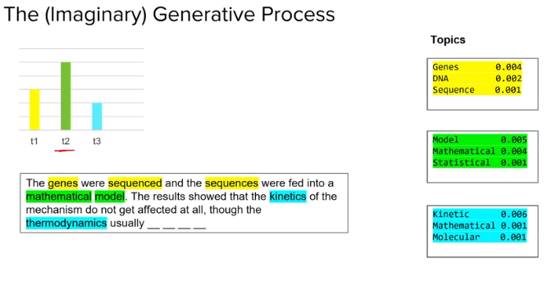
TOPIC MODELING
LDA converts this DTM into two lower dimensional matrices – M1 and M2.
It Iterates through each word w for each document d.
Each word w is assigned to a topic k with a probability P (which is a product of two probabilities p1 and p2.)
P1 – p(topic t / document d) = the proportion of words in document d that are currently assigned to topic t.
P2 – p(word w / topic t) = the proportion of assignments to topic t over all documents that come from this word w.
 | K1 | K2 | K3 | Kj
D1 | 1 | 0 | 1 | 0
D2 | 1 | 1 | 2 | 3
D3 | 3 | 0 | 0 | 1
Dn | 0 | 2 | 0 | 0
 | W1 | W2 | W3 | Wm
K1 | 3 | 1 | 1 | 3
K2 | 0 | 3 | 0 | 0
K3 | 1 | 0 | 3 | 1
Kn | 2 | 1 | 0 | 0
Document-Topics Matrix
M1
Topic-Terms Matrix
M2

Slide 44

Word2Vec
Problems with the text feature vectorizers like count vectorizers and TFIDF vectorizers are:
High Dimensionality
Limited vocabulary
Word Embeddings are a compressed, low dimensional version of the mammoth-sized text feature vectors
What are the different ways we can generate Word Embeddings ?
Frequency-based approach: Reducing the term-document matrix (which can as well be a TF-IDF, incidence matrix etc.) using a dimensionality reduction technique such as SVD
Prediction based approach: In this approach, the input is a single word (or a combination of words) and output is a combination of context words (or a single word). A shallow neural network learns the embedding's such that the output words can be predicted using the input words.

Slide 45
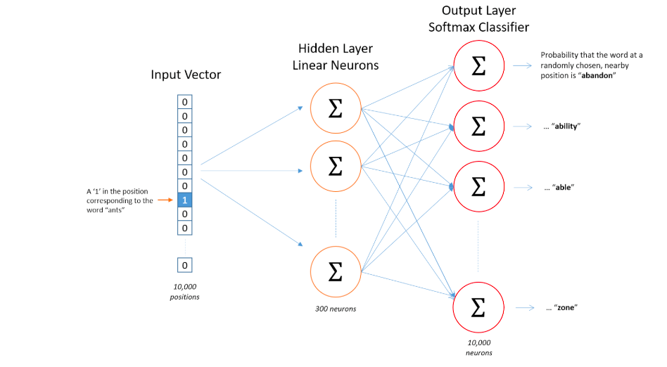
Word2Vec
Word2vec is a prediction based approach for creating word embeddings using some large corpora as the training data.
The first step is to create a distributed representation of the corpus using a technique such as skip-gram where each word is used to predict the neighboring ‘context words’.
Assuming we have a large corpus of vocabulary |V| = 10,000 words. The task is to create a word embedding of say 300 dimensions for each word
The model’s (a neural network) task is to learn to predict the context words correctly for each input word. The input to the network is a one-hot encoded vector representing one term.

Slide 46
Word2Vec
The hidden layer is a layer of neurons - in this case, 300 neurons. Each of the 10,000 elements in the input vector is connected to each of the 300 neurons.
Each of these 10,000 x 300 connections has a weight associated to it. This matrix of weights is of size 10,000 x 300, where each row represents a word vector of size 300.
The output of the network is a vector of size 10,000. Each element of this 10,000-vector represents the probability of an output context word for the given (one-hot) input word.
For e.g., if the context words for the word ‘ants’ are ‘bite’ and ‘walk’, the elements corresponding to these two words should have much higher probabilities (close to 1) than the other words. This layer is called the softmax layer since it uses the 'softmax function' to convert discrete classes (words) to probabilities of classes.

Slide 47

Word2Vec
TRAINING
There are two popular methods that we can use to train our embedding's weights: skip-gram and continuous bag of words (CBOW).
SKIP-GRAM
The idea behind skip-gram is to take in a word and predict the context words.
E.g. lets generate training data from a sentence like “the quick brown fox jumped over the lazy dog”
We need to predict context words from a target word where the context words are the words to the left and to the right of the target word. We will choose a window size (1 in this case) to decide how far left and right to go. The training data for the sentence above will look like this:
(quick, the),(quick, brown),(brown, quick),(brown, fox) …
The idea is to be able to train our weights so that we predict context words from target words. So when we input ‘quick’, we should receive ‘the’. We do this across the entire training set because we want to adjust the weights for all of our words using all the context we have available.

Slide 48
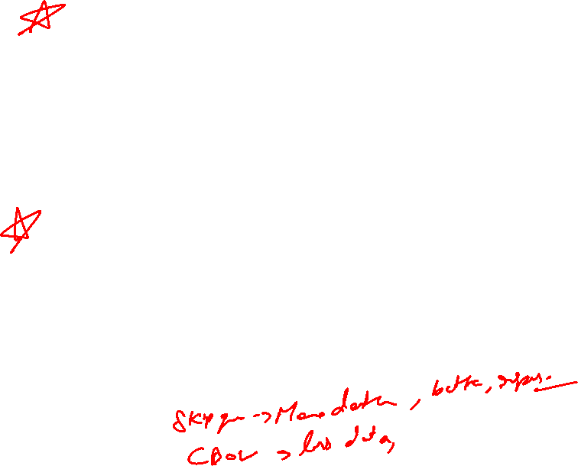
Word2Vec
CBOW
The continuous bag of words method allows us to create the training data for adjusting our embedding weights in a different way.
Instead of predicting context words from target, we will feed in context words and try to predict the target word. So now the training data (with window of 1) will look something like
( [ ‘the’ , ‘brown’ ] , ‘quick’ )
where we sum the embeddings of ‘the’ and ‘brown’ and expect to predict ‘quick’.
COMPARISON
Though CBOW (predict target from context) and skip-gram (predict context words from target) are just inverted methods to each other, each have their advantages/disadvantage.
Since CBOW can use many context words to predict the target word, it acts like regularization and offers very good performance when our input data is not so large.
However the skip-gram model is more fine grained so we are able to extract more information and essentially have more accurate embeddings when we have a large data set
( Large data is the best regularizer )

Slide 49
Word2Vec
Other Word Embeddings
After the success of Word2Vec, several other effective word embedding techniques have been developed by various teams. One of the most popular is GloVe (Global Vectors for Words) developed by a Stanford research group. Another recently developed and fast-growing word embedding library is fastText developed by Facebook AI Research (FAIR).
These embeddings are trained on billions of words (i.e. unique tokens), and thankfully, are available as pre-trained word vectors ready to use for text applications (for free!).
Additional Readings
Word2Vec: Original paper of word2vec by Mikolov et al.
GloVe vectors: Homepage (contains downloadable trained GloVe vectors, training methodology etc.).
fastText: Word embeddings developed by FAIR on multiple languages, available for download here

Slide 50
Appendix- Topic wise Reading Reference
Topics | Reading Reference
Regex | https://regexone.com
Bag of Words Model | https://machinelearningmastery.com/gentle-introduction-bag-words-model/
TF-IDF | https://stevenloria.com/tf-idf/ , http://blog.christianperone.com/2011/09/machine-learning-text-feature-extraction-tf-idf-part-i/ , http://aimotion.blogspot.com/2011/12/machine-learning-with-python-meeting-tf.html
Stemming and Lemmatization | https://nlp.stanford.edu/IR-book/html/htmledition/stemming-and-lemmatization-1.html
POS- Tagging | https://nlpforhackers.io/training-pos-tagger/ , https://pythonprogramming.net/part-of-speech-tagging-nltk-tutorial/ , https://towardsdatascience.com/part-of-speech-tagging-with-hidden-markov-chain-models-e9fccc835c0e ,
Parsing | https://www.commonlounge.com/discussion/1ef22e14f82444b090c8368f9444ba78
Named Entity Recognition | https://www.commonlounge.com/discussion/d5abf44e9d09490b8653dd75feff760e
Word Net | https://pythonprogramming.net/wordnet-nltk-tutorial/
Concept Net | http://conceptnet.io/ , http://tomkdickinson.co.uk/2017/05/combining-wordnet-and-conceptnet-in-neo4j/
Topic Modelling | https://www.youtube.com/watch?v=BuMu-bdoVrU
Word2Vec | https://arxiv.org/pdf/1411.2738.pdf , http://mccormickml.com/2016/04/19/word2vec-tutorial-the-skip-gram-model/ https://www.youtube.com/watch?v=TsEGsdVJjuA

Slide 51
Appendix- NLP Tutorials
POPULAR VIDEOS AND ARTICLES
Text mining (NLP) with Python – Implementation Tutorial | https://nbviewer.jupyter.org/github/TiesdeKok/Python_NLP_Tutorial/blob/master/NLP_Notebook.ipynb
NLP Workshop – Concrete Solution to Real World Problem | https://github.com/hundredblocks/concrete_NLP_tutorial
NLP With Deep Learning – Stanford School OF Engineering | https://www.youtube.com/watch?v=OQQ-W_63UgQ&list=PL3FW7Lu3i5Jsnh1rnUwq_TcylNr7EkRe6
Compilation of 150 NLP and Python Tutorial | https://medium.com/machine-learning-in-practice/over-150-of-the-best-machine-learning-nlp-and-python-tutorials-ive-found-ffce2939bd78
Step by Step Guide | https://blog.insightdatascience.com/how-to-solve-90-of-nlp-problems-a-step-by-step-guide-fda605278e4e
Ultimate Guide to Understand and Implement NLP | https://www.analyticsvidhya.com/blog/2017/01/ultimate-guide-to-understand-implement-natural-language-processing-codes-in-python/
https://paperswithcode.com/area/natural-language-processing
http://nlpprogress.com/

Slide 52

#LifeKoKaroLift
Thank You!

